Slide 1


Data Storytelling with Power BI
Notes:
Happy morning guys. I am Dinesh Kumar. Product Manager at Syncfusion Software. I act as Growth Hacker for the Data Platform. And I am happy to present this online session to you all. Here we go!

Slide 2
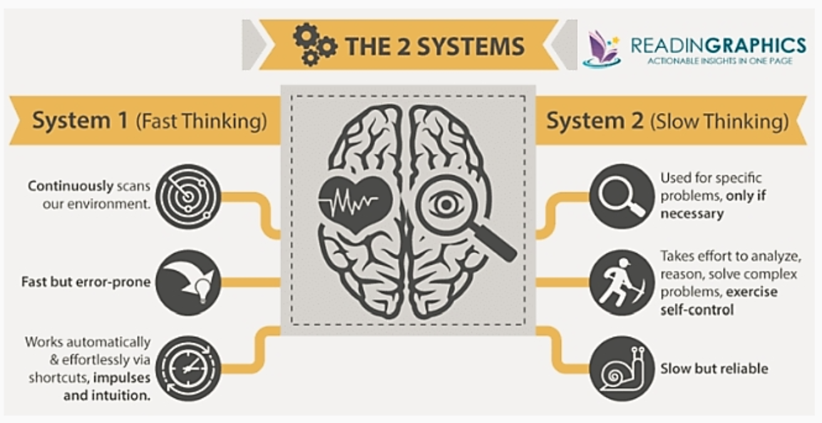
Notes:
Brain has different learning and decision making systems. Same way Data Storytelling helps our brain to understand things faster and better.

Slide 3
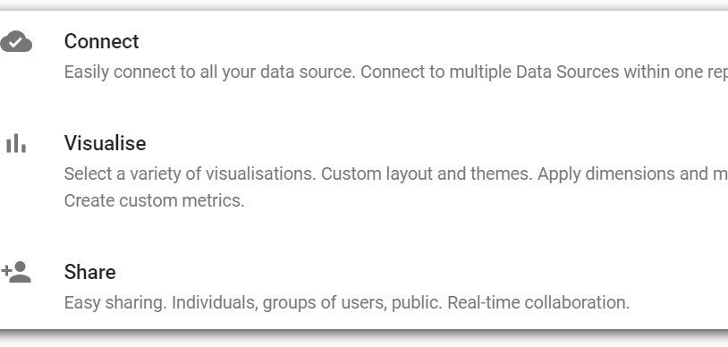
Notes:
Any BI tool will be addressing the following requirements:
It would enable connectivity in different business apps with ease along with security standards maintained during data transfers.
It would allow analyzing those data.
It would allow creating effective visuals easily and should be able to narrate the insights on its own.
The difference between different tools would be like, number of data source connections / number of charts / administrator features like user management / usability / cost factor / embedding and so on.

Slide 4
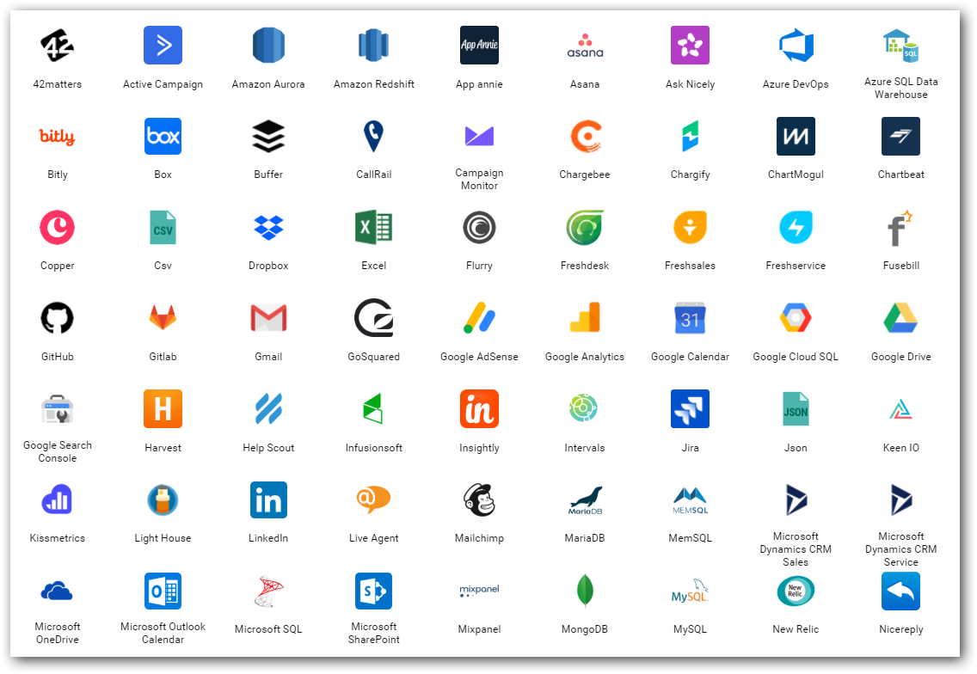
Data sources
Find out from where you need to get the data for your project.
Either provided or should search and find.
Logs
Databases
Web (REST APIs)
Social Media
…

Slide 5
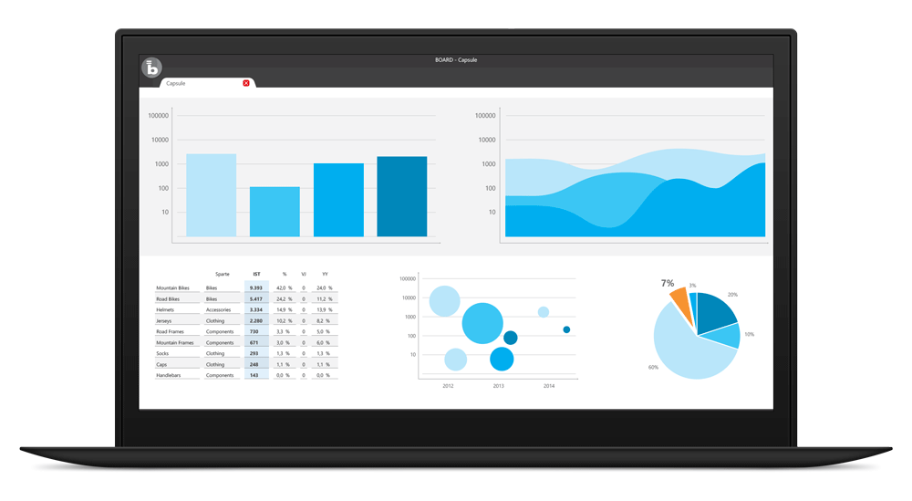
Visualize
BI tools for business decisions,
Microsoft Power BI
Tableau
Qlik
Bold BI
…
In-built packages in R, Python
Notes:
Most important.
This is how the top cream layer gets the view of their business as a story.

Slide 6
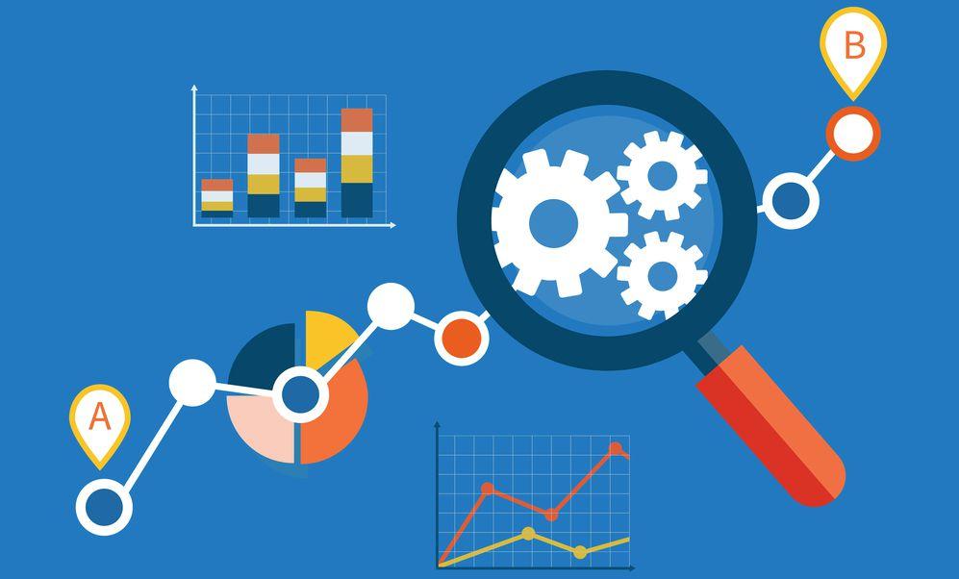
Importance of Storytelling
How to convey your boss with data in Excel with thousands of rows?
Just convey it as a bar chart / pie chart instead of explaining numbers.
Meaning and purpose to the original data.
See the story that lives in your data.
Discover patterns (HISTORY), metrics (CURRENT) and spot trends (FUTURE).

Slide 7
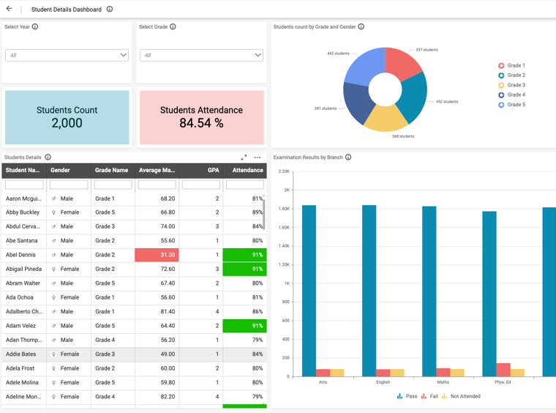
Understandable to all
One Student Performance Analysis Dashboard for entire college;
Principal/Secretary – All departments.
Department head – Specific department.
Class Tutors – Specific class.
So the dashboards should be filled-up with visuals understandable for all levels of people.
Notes:
One will look into a dashboard only if he feels he gets some insights out of it.

Slide 8
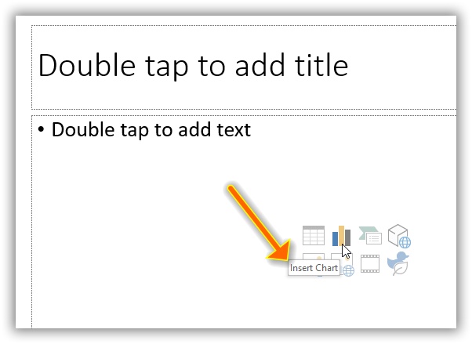
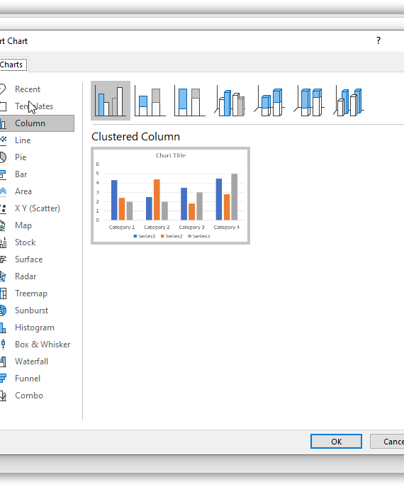
PowerPoint
Notes:
Visuals in PowerPoint. A miniature of Excel and Power BI into PowerPoint itself.

Slide 9
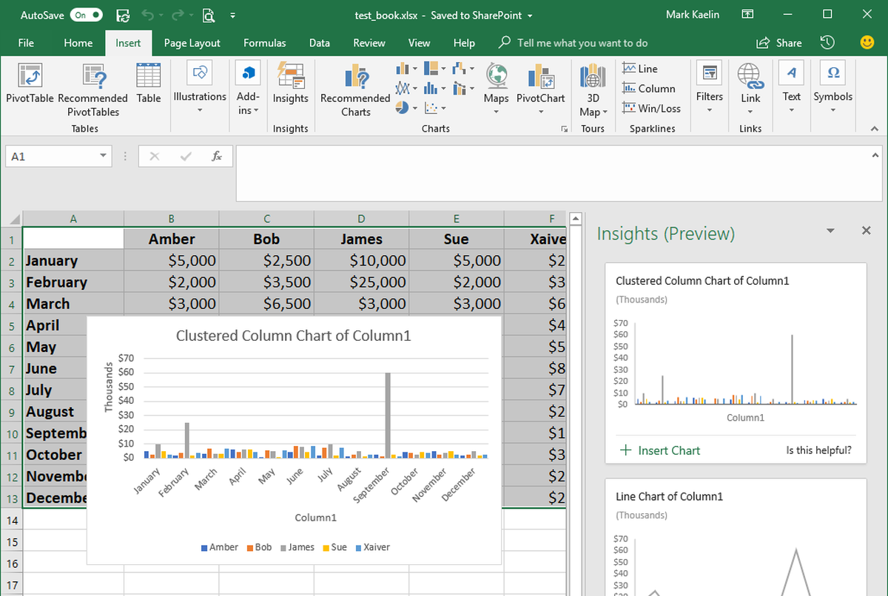
Excel
Notes:
Do we have anyone here know about or using “Ideas” in Excel?
Evolving as Automatic Storyteller.
Quickest and easiest way of Learning data analysis and storytelling.
Works only with internet.
Demo
COVID-19 Data as Sheets, Dashboards, Story.
For Outliers – Show Energy Data as example.

Slide 10

Basic things to know for Storytelling

Slide 11
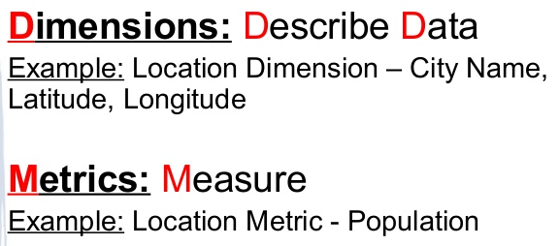
Dimensions vs Measures

Slide 12

Three things for effective visualization
Always audience in mind.
Clever in COLORS.
Use more Words.
June 2019
June 2020
Copyright © 2020 Syncfusion, Inc. All rights reserved.
Notes:
As mentioned in the first slide, effectively communicating the extracted insight to the target audience is important. These are 3 simple skills to improve the storytelling with data.
First and foremost is being specific about who your audience is. One should design everything keeping that audience in mind. Creating a chart for a communication purpose for our understanding is an easy task. If we step out of ourselves and think how do, we design for our audience will give effective results. Thinking is nothing but knowing ‘who are they’, ‘what do they care or expect’, ‘what keeps them up at night’.. Designing dashboards, keeping such motivation factors in mind will allow us to get their attention and can get our message across easily.
Next, coming to colors – It is not only about using pleasing colors in a dashboard. Think about where your audience to look and create a sparing contrast to achieve the attention.
Next, we should use more words in a dashboard. I mean it is words not sentences. Like axis labels, value labels, titles in a dashboard. Really these words will give more meaning quickly to the numbers and charts present in a dashboard.
https://visme.co/blog/dos-and-donts-chart-making/
https://infogram.com/blog/color-theory-dos-and-donts-for-data-visualization/

Slide 13
Three things for effective Storytelling
Always audience in mind.
Clever in COLORS.
Use more Words.
June 2019
June 2020
Copyright © 2020 Syncfusion, Inc. All rights reserved.

Slide 14
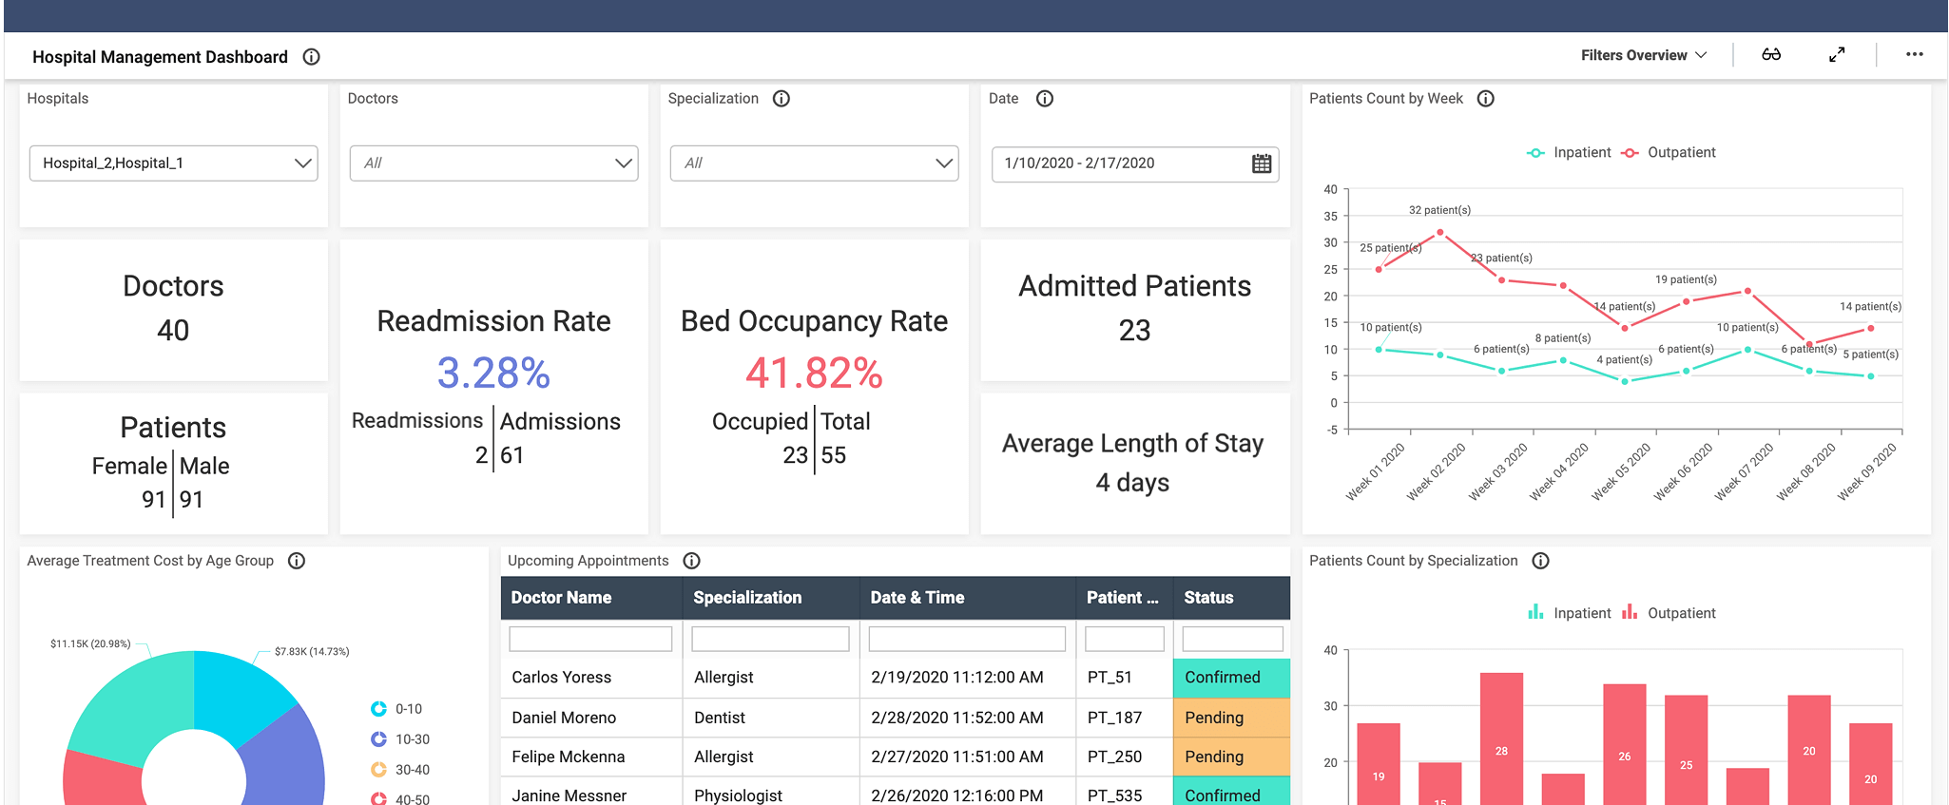
Positioning the KPIs
Notes:
https://demo.boldbi.com/bi/en-us/dashboards/dd055313-794e-4bc3-b53e-e949170b3331/

Slide 15
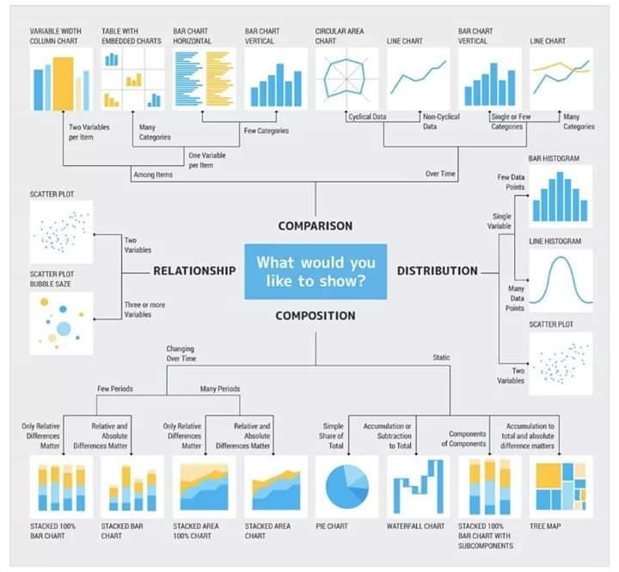
Notes:
This is like a rule book which most of us would be using while we get confused between choosing chart type.

Slide 16
Can you Answer?
Which one of the following is a Measure?
Sales Revenue
Sales Region
Sales Date
Notes:
Measures are numerical values that mathematical functions work on. Which one of the following is a Measure?

Slide 17
Can you Answer?
Which one of the following is a dimension?
Age of a person
Salary of a person
Notes:
By exercising Data Profiling

Slide 18
COVID-19 dashboard using Microsoft Power BI
Demo
Notes:
https://app.powerbi.com/groups/me/reports/279cdc82-8a49-487c-b015-21d6eb900de0/ReportSection0e72bac688f60e7252ea?noSignUpCheck=1
Open web power bi. Connect to SQL server own COVID-19 data. Start designing and show the best practices with that.
Finally show already created 2 dashboards and tell the story.

Slide 19
Can you Answer?
What is the new feature in Excel that does automatic data visualization?
Notes:
Ideas

Slide 20
Can you Answer?
A chart that explains daily new cases by each day comes under,
Comparison
Composition
Relationship

Slide 21

Notes:
Now let me play this video - https://www.linkedin.com/posts/dinesh-kumar-prabakaran-b95a6656_leaders-weekend-friday-activity-6678894065909686272-mlHS/
Did you see guys? How powerful the visualization is? Mind understands and gives priority about what it sees first before what it can hear by words.

Slide 22

Thank you! Questions ??

